Slide 1
Samba KCC: Saying No to Full Mesh Replication
Garming Sam Catalyst IT, Samba Team
Notes:
1
1

Slide 2
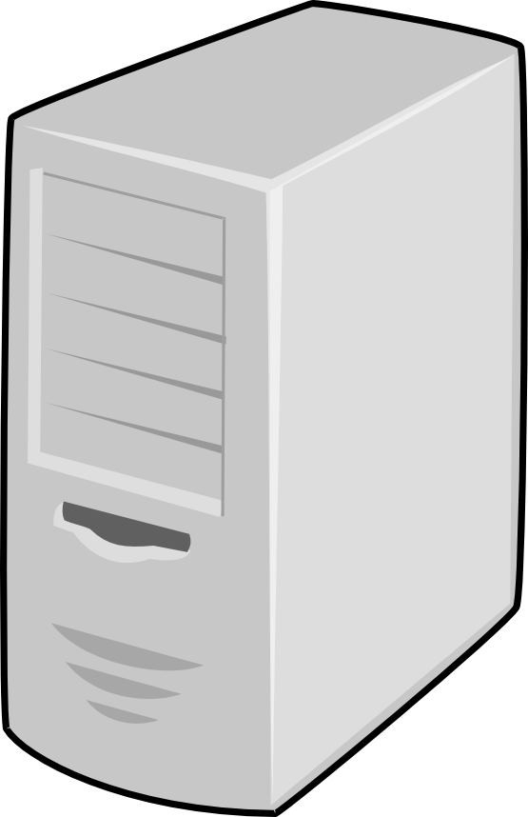
What is the KCC?
Knowledge consistency checker
Used to manage replication connections in AD
Set of algorithms to produce efficient network topologies
Site B
Site D
Site A
Site C
Notes:
2
2

Slide 3
What is the KCC?
Notes:
3
3

Slide 4
What is the KCC?
Notes:
4
4

Slide 5
What is the KCC?
Notes:
5
5

Slide 6
What is the KCC?
Notes:
6
6

Slide 7
History of the KCC
Original full-mesh C code
Attempt at MS-ADTS algorithms in C
Dave Craft (2011) on Python inter-site algorithms
Late 2014—Early 2015 Douglas and myself
Samba 4.3 introduced, Samba 4.5 set as default
Notes:
7
7

Slide 8
Stages of the algorithm
Intra-site algorithm
Inter-site algorithm
Removing unneeded connections
Translate connections
Although the KCC creates ‘connection’ objects, they may not represent the underlying replication. They are only the implied connections given the current network topology.
Notes:
8
8

Slide 9
Pre-requisites
Transport – IP
dn: CN=IP,CN=Inter-Site Transports,CN=Sites,CN=Configuration,DC=example,DC=com
objectClass: interSiteTransport
Sites – Default-First-Site
dn: CN=Default-First-Site-Name,CN=Sites,CN=Configuration,DC=example,DC=com
objectClass: site
dn: CN=NTDS Site Settings,CN=Default-First-Site-Name,CN=Sites,CN=Configuration,DC=example,DC=com
objectClass: nTDSSiteSettings
interSiteTopologyGenerator: CN=NTDS Settings,CN=DC,CN=Servers,CN=Default-First-Site-Name,CN=Sites,CN=Configuration,DC=example,DC=com
Notes:
9
9

Slide 10
Pre-requisites
Site-Links – DEFAULTIPSITELINK
dn: CN=DEFAULTIPSITELINK,CN=IP,CN=Inter-Site Transports,CN=Sites,CN=Configuration,DC=example,DC=com
objectClass: siteLink
cost: 100
siteList: CN=Default-First-Site-Name,CN=Sites,CN=Configuration,DC=example,DC=com
Site-links define the allowable connections between sites.
Site-links needs to collectively span your entire network.
Notes:
10
10

Slide 11
Pre-requisites - Scenarios
SITELINKA
Site-1
Site-2
Default-First-Site
Site-3
DEFAULTIPSITELINK
SITELINKB
Notes:
11
11

Slide 12
Intra-site algorithm
Ring topology, with a few extra connections
Notes:
12
12

Slide 13
Intra-site algorithm
Ring topology, with a few extra connections
Notes:
13
13

Slide 14
Intra-site algorithm
Every DC in the site has a sorted list of site DCs
Notes:
14
14

Slide 15
Intra-site algorithm
Compared to the old KCC, there are fewer connections
The algorithm is quite reliable, adding additional connections
Information propagates in a more controlled manner
In a single-site use-case, with not that many DCs, behaviour should be quite similar to the old code.
Notes:
15
15

Slide 16
Inter-site algorithm
Each site elects an inter-site topology generator (ITSG)
Re-election attempts to occur if the ITSG is not responding
Attribute: interSiteTopologyFailover
Site B
Site D
Site A
Site C
Notes:
16
16

Slide 17
Inter-site algorithm
Stable answer across entire DC network
One DC per site managing inter-site connections
Needs to be as fault tolerant as possible
Must produce topology optimizing cost and schedules
Notes:
17
17

Slide 18
Inter-site algorithm
Site B
Site A
Site C
Site D
Bridgehead servers are the end-point connections between sites.
Notes:
18
18

Slide 19
Inter-site algorithm
Site B
Site A
Site C
Site D
Being a bridgehead does not imply being an ITSG.
Notes:
19
19

Slide 20
Inter-site algorithm
Site B
Site A
Site C
Site D
There is not necessarily a single bridgehead server.
Notes:
20
20

Slide 21
Inter-site algorithm
DC1
DC2
pulls from
There is only pull replication. Bi-directional replication must be done with two distinct connections.
Notes:
21
21

Slide 22
Inter-site algorithm
Site B
Site A
Site C
Site D
The inter-site algorithm only runs on the ITSG.
Notes:
22
22

Slide 23
Inter-site algorithm
Site B
Site A
Site C
Site D
Notes:
23
23

Slide 24
Inter-site algorithm
Site B
Site A
Site C
Site D
A new connection will be created in the database pointing to a randomly chosen bridgehead in Site A. Intra-site replication will propagate this to the necessary bridgehead in Site D.
Notes:
24
24

Slide 25
Inter-site algorithm
Site B
Site A
Site C
Site D
The incoming bridgehead runs the KCC and notices the new connection. It has no idea why it connects to the DC, that’s the role of the ITSG.
Notes:
25
25

Slide 26
Inter-site algorithm – TODO kruskal
Site B
Site A
Site C
Site D
The incoming bridgehead runs the KCC and notices the new connection. It has no idea why it connects to the DC, that’s the role of the ITSG.
Notes:
26
26

Slide 27
Remove unneeded connections - TODO
Stable answer across entire DC network
Used to manage replication connections in AD
Set of algorithms to calculate efficient network topologies
ascending ReplInfo.Cost,
descending available time in ReplInfo.Schedule,
Overlapping schedule…
One dc per site… you might want more connections (old KCC)
Notes:
27
27

Slide 28
Two independent tasks running
KCC running periodically
Creating NTDS Connection objects (ITSG or intrasite)
Translating NTDS Connections to repsFrom
DREPL server
Reading repsFrom and pulling from the target
This means it can take some time to propagate.
Notes:
28
28

Slide 29
Translate connections - TODO
Stable answer across entire DC network
Used to manage replication connections in AD
Set of algorithms to calculate efficient network topologies
Notes:
29
29

Slide 30
The overall effect
Single path from any site to any site (property of a tree)
Changes should not bounce around significantly
Significantly reduced replication traffic
Ability to customize who should talk to who
Small networks (n <= 4) should have no visible effect
Larger networks with varying connectivity shows huge effect
Notes:
30
30

Slide 31
Challenges
Verbose documentation
‘Multi-edge’, hyper-edge?
White, red, black vertices?
Notes:
31
31

Slide 32
More challenges
Logical inconsistencies, ambiguities and omissions
Pseudo-code vs textual description
Easy to debug your own bugs
Testing?
--dot-file-dir
--export-ldif, --import-ldif
Notes:
32
32

Slide 33
Incomplete features
Trusted domains and global catalog replication
RODC self-management
Site-Link-Bridge Topologies
Respecting schedules and other AD attributes
Preferred bridgehead servers
Notes:
33
33

Slide 34
Incomplete features
Failed connection and failed DC failover
Better stale connection clean-up
MS-DS-Replicates-NC-Reason
Use normal replication to propagate failure info
Better debugging and failure information
Better defaults for modern networks
Notes:
34
34

Slide 35
Alternative topology strategies
What is the best topology for various networks?
Ring algorithm from intra-site for inter-site
Minimum cost spanning tree plus additional connections
Fully connected bridge-head servers
Notes:
35
35

Slide 36
With Samba 4.5, the new site-aware Samba Knowledge Consistency Checker (KCC) has been turned on by default. Instead of using full mesh replication between every DC, the KCC will set up connections to optimize replication latency and cost (using site links to calculate the routes). Although there is more effort required in establishing effective site topologies, it has enabled users to create larger and more distributed networks without any of the previous replication penalties. It has also meant that Samba AD can be aware of particular details of a network (such as satellite links or certain firewall restrictions) to ensure that information flows through the network in a reasonable way. The aim is to look at how sites in AD generally work, what role the KCC performs, and what implications this new feature has on a range of different networks.
Notes:
36
36

Slide 37

Notes:
37
37

Slide 38
Notes:
38
38

Slide 39
2637 # Step 1
2638 self.refresh_failed_links_connections(ping)
2640 # Step 2
2641 self.intrasite()
2643 # Step 3
2644 all_connected = self.intersite(ping) # overlay a failed network ontop of the expected
2646 # Step 4
2647 self.remove_unneeded_ntdsconn(all_connected)
2649 # Step 5
2650 self.translate_ntdsconn()
2652 # Step 6
2653 self.remove_unneeded_failed_links_connections()
2655 # Step 7
2656 self.update_rodc_connection()
Notes:
39
39

Slide 40
i1929 The KCC does not create more than 50 edges directed to a
1930 single DC. To optimize replication, we compute that each node
1931 should have n+2 total edges directed to it such that (n) is
1932 the smallest non-negative integer satisfying
1933 (node_count <= 2*(n*n) + 6*n + 7)
Notes:
40
40

Slide 41
Select ITSG
1140 An intersite graph has a Vertex for each site object, a
1141 MultiEdge for each SiteLink object, and a MutliEdgeSet for
1142 each siteLinkBridge object (or implied siteLinkBridge). It
1143 reflects the intersite topology in a slightly more abstract
1144 graph form.
Notes:
41
41

